Slide 1
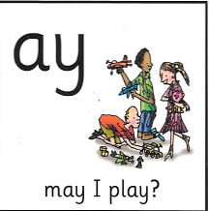
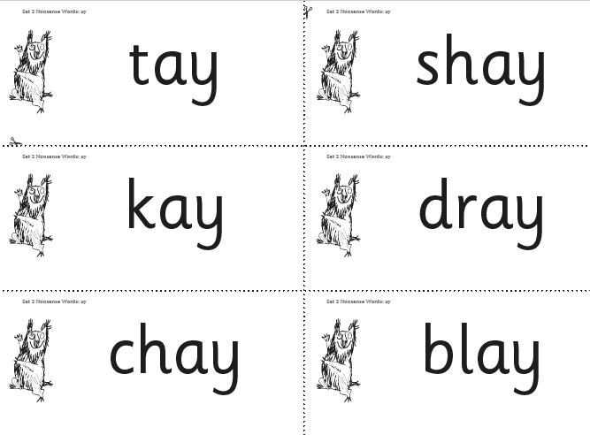
Phonics Homework Please practice saying the sound and reading the real and alien words. Ask your child to look for ‘special friends’ and to ‘Fred Talk’
Real Words
play
say
may
day
Alien Words

Slide 2
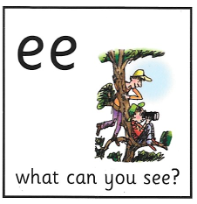
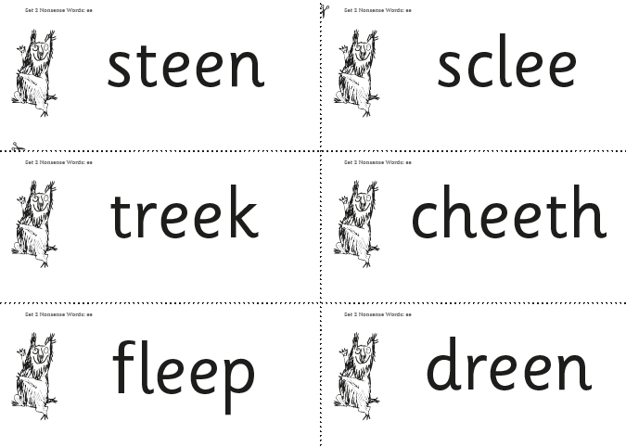
Phonics Homework Please practice saying the sound and reading the real and alien words. Ask your child to look for ‘special friends’ and to ‘Fred Talk’
Real Words
see
meet
keep
greet
Alien Words

Slide 3
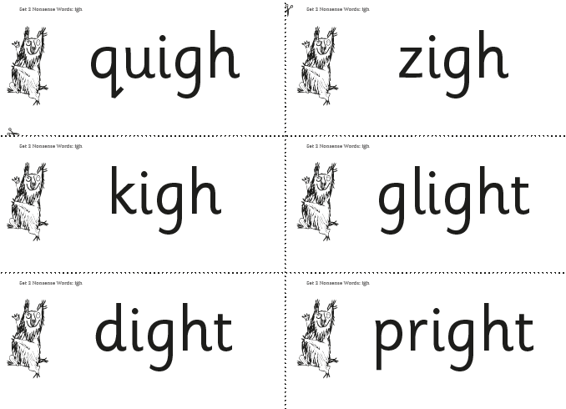
Phonics Homework Please practice saying the sound and reading the real and alien words. Ask your child to look for ‘special friends’ and to ‘Fred Talk’
Real Words
high
might
fight
sight
Alien Words

Slide 4
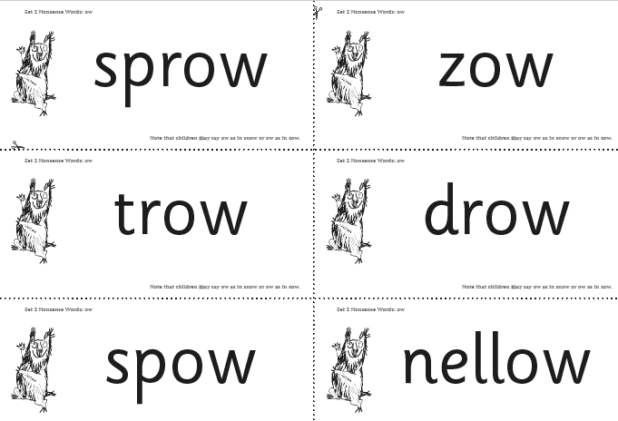
Phonics Homework Please practice saying the sound and reading the real and alien words. Ask your child to look for ‘special friends’ and to ‘Fred Talk’
Real Words
blow
snow
flow
throw
Alien Words

Slide 5
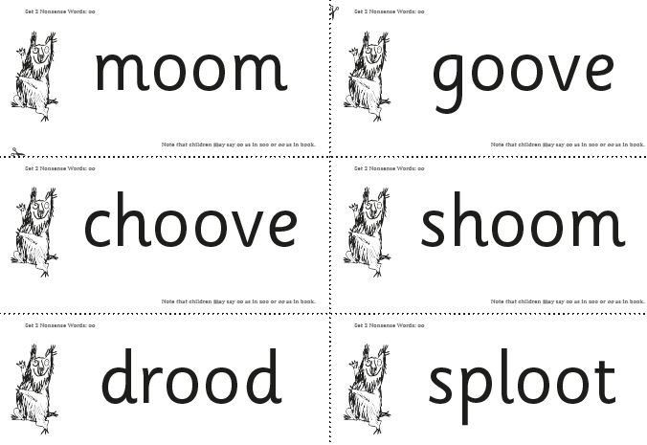
Phonics Homework Please practice saying the sound and reading the real and alien words. Ask your child to look for ‘special friends’ and to ‘Fred Talk’
Real Words
zoom
food
choose
moon
Alien Words

Slide 6
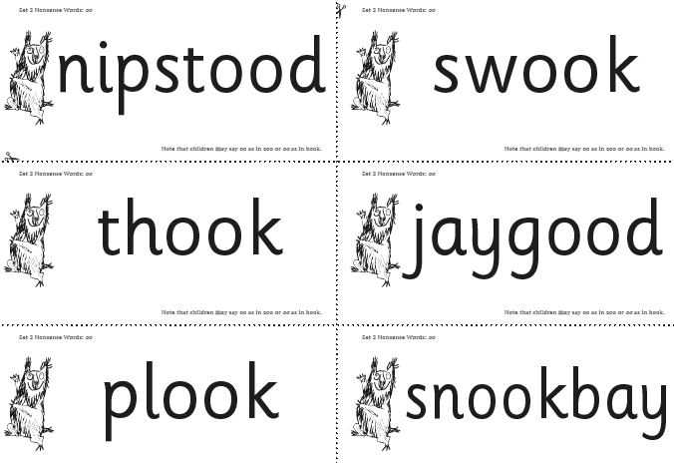
Phonics Homework Please practice saying the sound and reading the real and alien words. Ask your child to look for ‘special friends’ and to ‘Fred Talk’
Real Words
book
look
shook
took
Alien Words

Slide 7
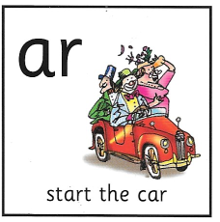
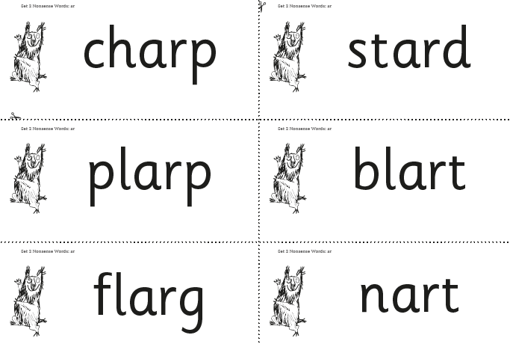
Phonics Homework Please practice saying the sound and reading the real and alien words. Ask your child to look for ‘special friends’ and to ‘Fred Talk’
Real Words
car
star
far
start
Alien Words

Slide 8
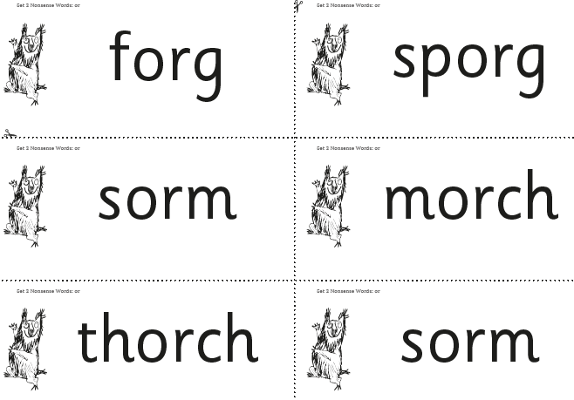
Phonics Homework Please practice saying the sound and reading the real and alien words. Ask your child to look for ‘special friends’ and to ‘Fred Talk’
Real Words
fork
short
born
thorn
Alien Words

Slide 9
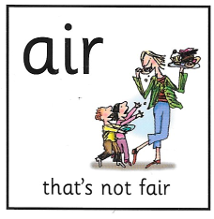
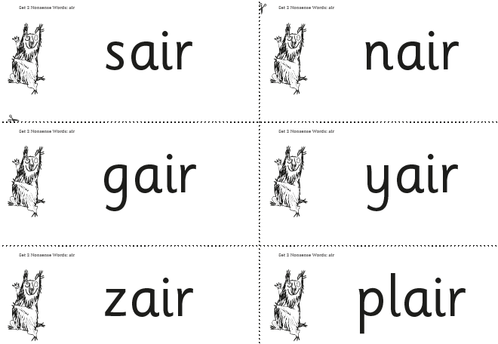
Phonics Homework Please practice saying the sound and reading the real and alien words. Ask your child to look for ‘special friends’ and to ‘Fred Talk’
Real Words
air
fair
chair
stair
Alien Words

Slide 10
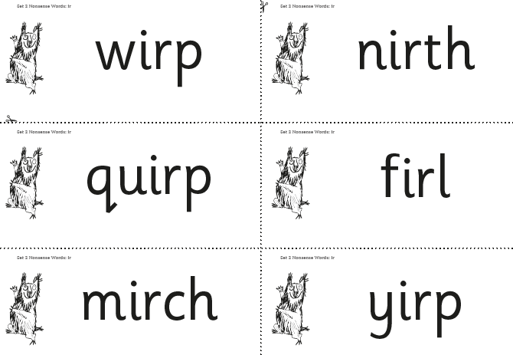
Phonics Homework Please practice saying the sound and reading the real and alien words. Ask your child to look for ‘special friends’ and to ‘Fred Talk’
Real Words
girl
swirl
whirl
twirl
Alien Words

Slide 11
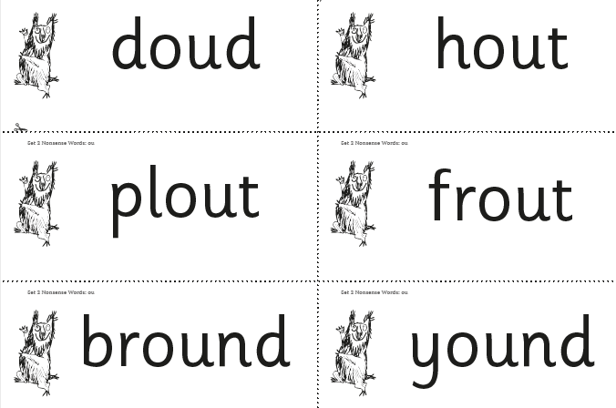
Phonics Homework Please practice saying the sound and reading the real and alien words. Ask your child to look for ‘special friends’ and to ‘Fred Talk’
Real Words
out
loud
proud
shout
Alien Words

Slide 12
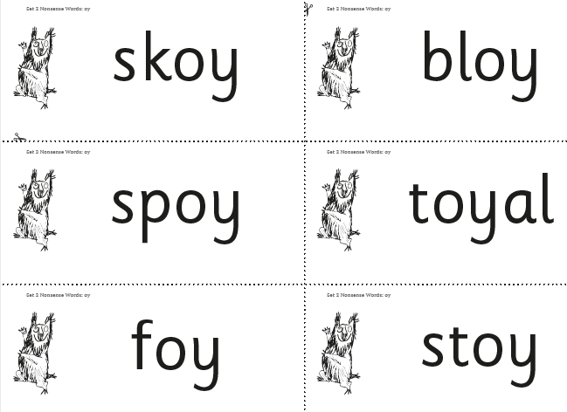
Phonics Homework Please practice saying the sound and reading the real and alien words. Ask your child to look for ‘special friends’ and to ‘Fred Talk’
Real Words
toy
boy
ahoy
annoy
Alien Words

