Slide 1
INTRODUCTION TO PHYSICAL AND HUMAN GEOGRAPHY

Slide 2
Learning Intention:
We are learning to define and identify the human and physical features of an Island.
Success Criteria:
I can explain the difference between a human and physical feature
I can sort the features and place them under the correct heading

Slide 3
Definitions
A physical feature is something which is natural – it happens naturally
E.g. land, water within a land, soil
A human feature is something man - made or it was made by a human being e.g. buildings

Slide 4
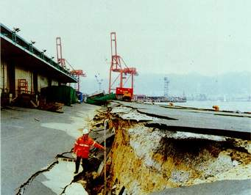
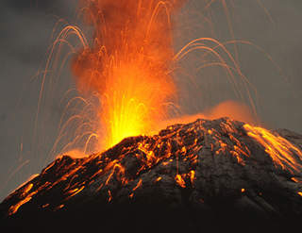
Starter
Identify the physical features below
Mountains
Rivers
Earthquakes
volcanoes

Slide 5
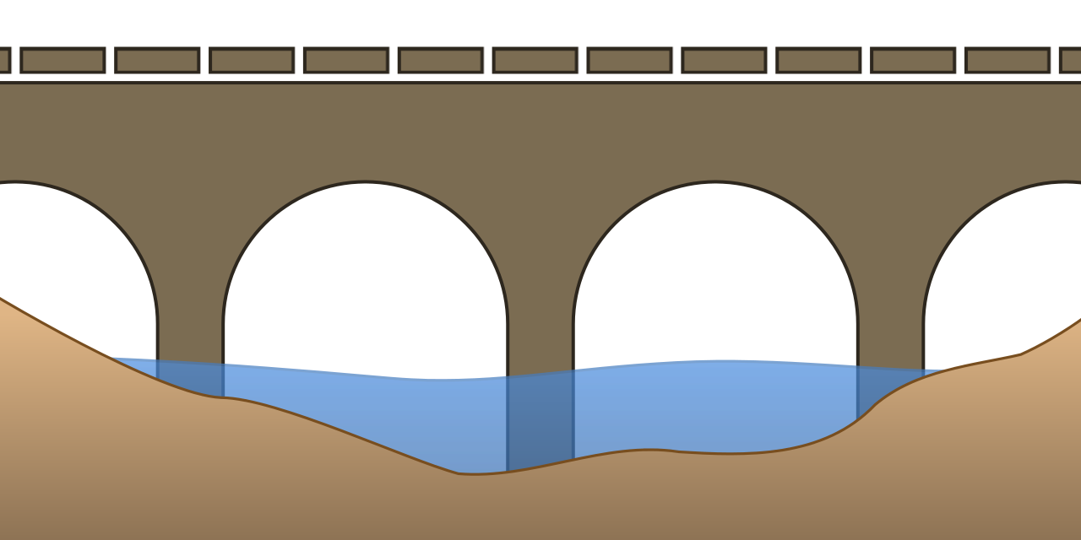
What kind of feature would a bridge be?
Human
Or
Physical

Slide 6
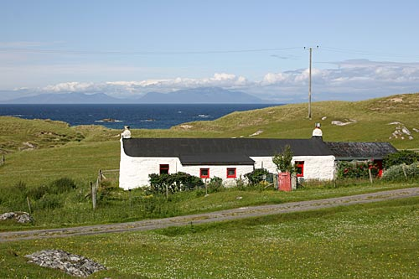
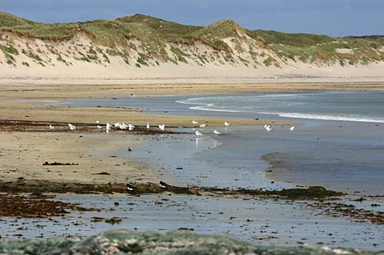
Can you sort the following?
Which is human feature and which is physical feature?
Village house The beach

Slide 7
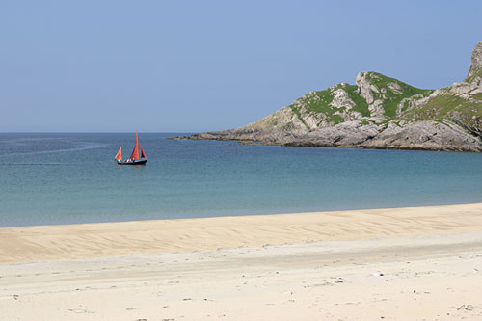
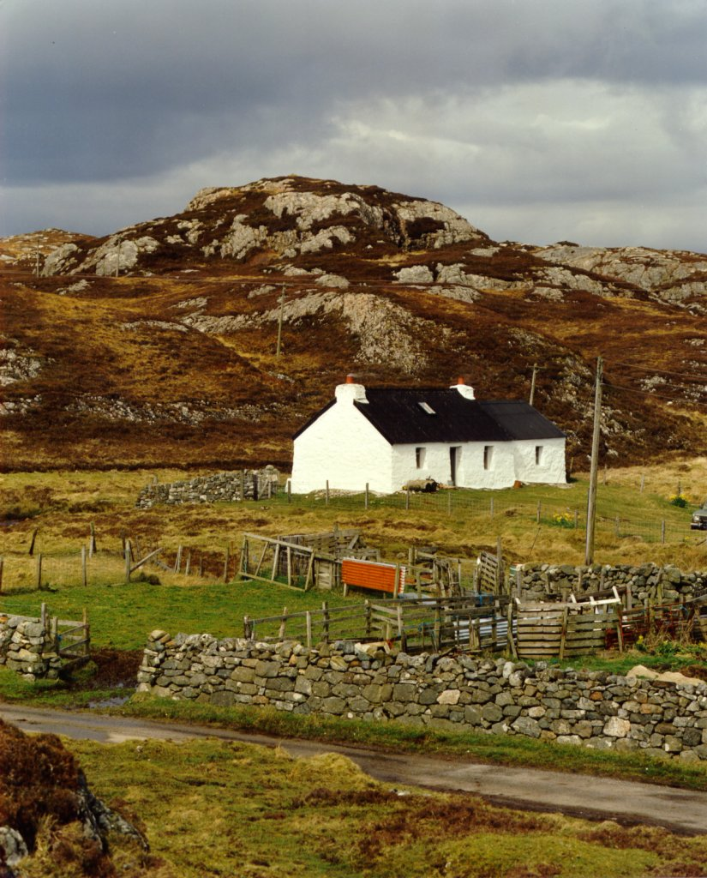
Which is human feature and which is physical feature?
The bay The farmhouse

Slide 8
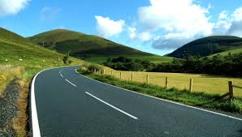
Which is human feature and which is physical feature?
Cliff Road

Slide 9
Geographical skills: photo interpretation
Atmosphere
cloud
Tree
mountain
River
Rock
vegetation

Slide 10
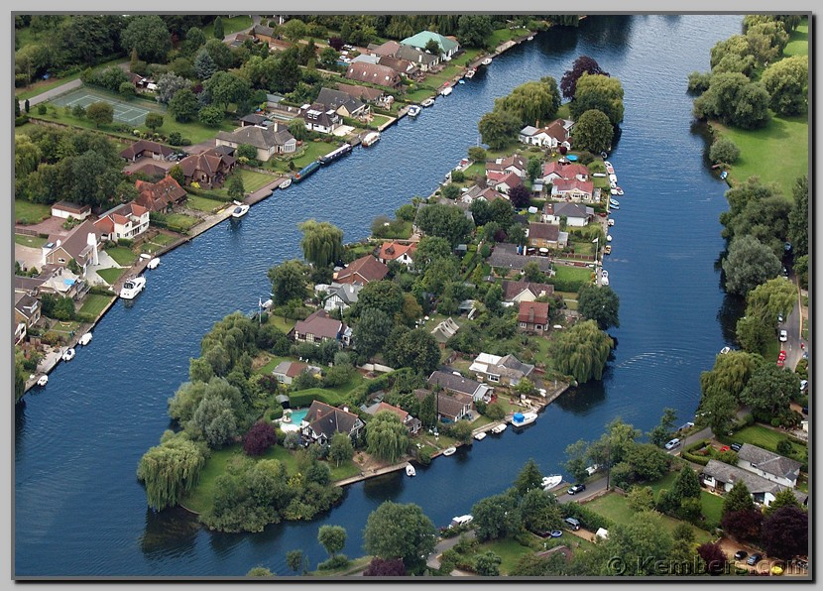
Photograph A

Slide 11
Answers for photograph A
Physical features Human features
Trees Houses/buildings
Fields/grassed areas Roads
River Tennis courts

Slide 12
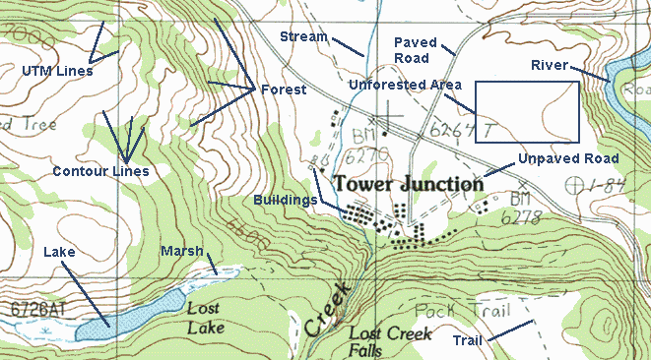
plenary
IDENTIFY THREE PHYSICAL and HUMAN FEATURES FROM THE MAP

